Slide 1
Measuring and Closing the Gender Pay gap
September, 2021 – SAGE Webinar
Dr Terry Fitzsimmons – 20th September, 2021
“If I am not for myself, who will be for me? If I am not for others, what am I? And if not now then when?” – Golda Meir

Slide 2
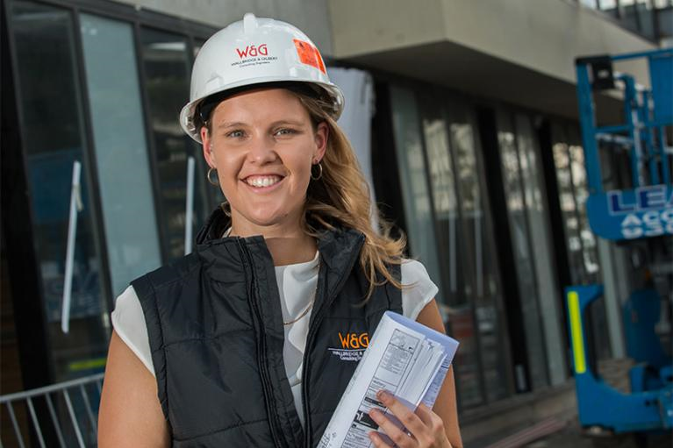
Gender Segregation in Leadership
Women represent 59.5% of Degree Qualified work entrants and have exceeded male graduates since 1985. (Department of Education and Training, 2019)
Australian female graduates of the same age, experience and qualifications earn 4.8% less than men upon graduation (WGEA, 2019)
5.0% Women CEOs in the ASX 200 (only 10 women). (ASX, Feb 2021)
The relative number of women CEOs in the ASX200 has moved from 4 in 2002 to 13 in 2017 and down to 10 in 2021. (ASX, 2013-2021; EOWA, 2002-2012)
Only 14% of direct quotes for stories in the AFR are from women. The lowest for any news publication in Australia. (Women for Media, 2019)
Only 14.8% of engineering graduates are women (2019) down from 17.1% in 2001 and only 2/3rds of these graduates undertake operational roles (Engineers Australia, 2019)

Slide 3
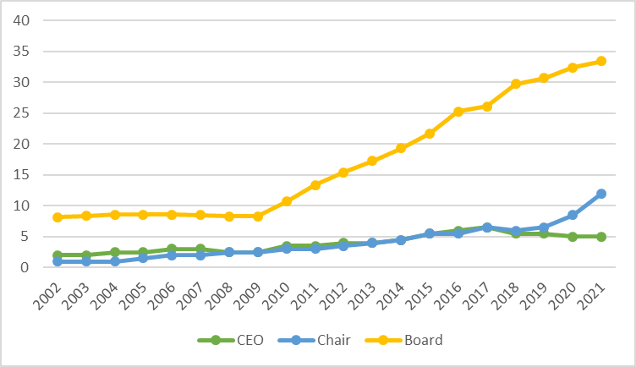
ASX200 - CEO Parity in 2306AD
%
New ASX gender reporting guidelines and ongoing AICD push for female board members
30% Target Reached
AICD and
30% Club
Target.
New target set at 40/40/20
On current trend gender parity in CEO roles for ASX200 will occur in 2306.
Projected from ‘Census of Women in Leadership’ EOWA 2002 - 2012,
ASX Company Database 2013-2021 (Feb 28, 2021), AICD (28 Feb, 2021)

Slide 4
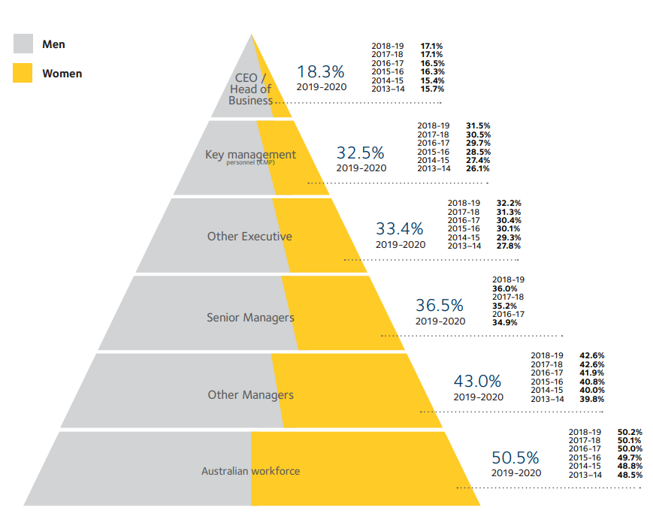
CEO Parity in the Broader Economy – 2083
+3.6% over 7 years (another 62 years until parity)
There is a continuing blockage for women wanting to enter CEO roles
Average of 4.2% total
increase over 7 years
(parity in 30 years)
WGEA (2020) Data Based upon reporting data from 4,943 firms with > 100 employees

Slide 5
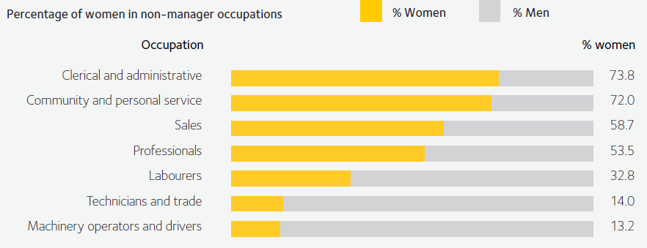
Occupational Gender Segregation
Indoor
Roles
Outdoor
Roles
Non Manager Roles Segregated by Occupation (WGEA, 2019)

Slide 6
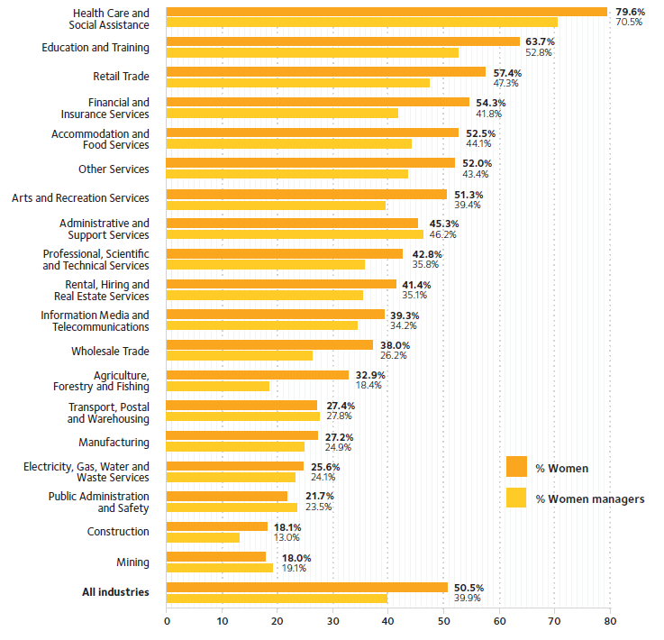
Industry Gender Segregation
Across the workforce, women and men are concentrated in different industries. Of the 19 industries in the Table, just eight have at least 40% women and men.
Women are concentrated in Health Care/Social Assistance and Education and Training and least represented in Construction and Mining.
Proportion of women employees and representation in management by industry. (WGEA, 2020)

Slide 7
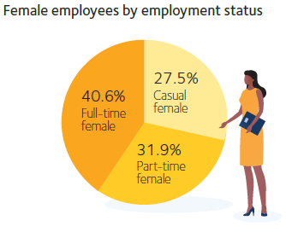
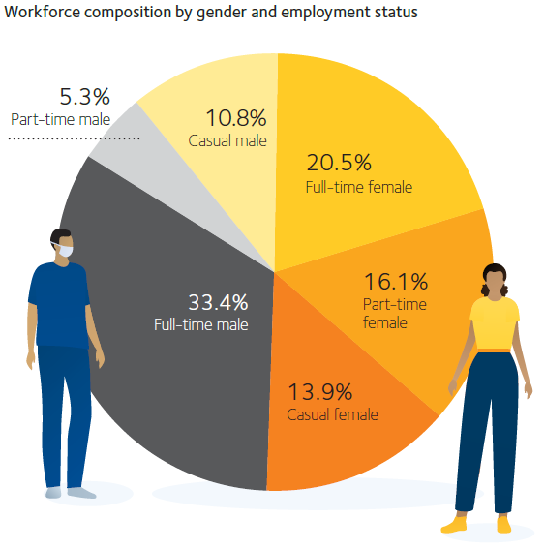
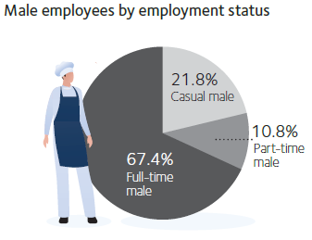
Employment Type Gender Segregation
Women currently represent 50.5% of the Australian workforce.
However, women are concentrated in more vulnerable casual and part-time roles.
Proportion of women and men employees by employment type. (WGEA, 2020)

Slide 8
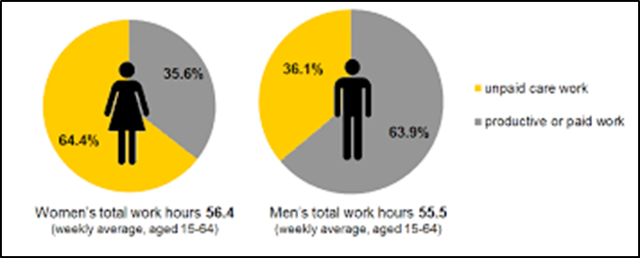
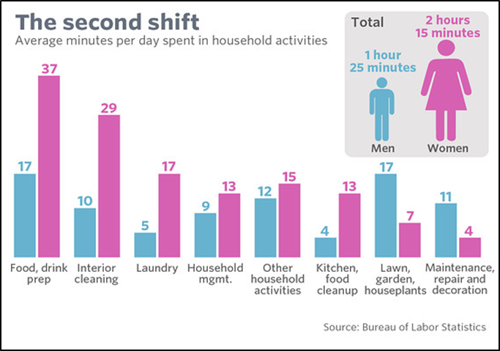
Domestic Labour Gender Segregation
The division of domestic labour, even where both partners work full time, has been stubbornly persistent over the past 50 years.
Research suggests that COVID19 has exacerbated this division with additional burden being placed on women, especially during lockdowns.
Gender Differences in time spent on domestic duties is time lost to career progression potential.

Slide 9
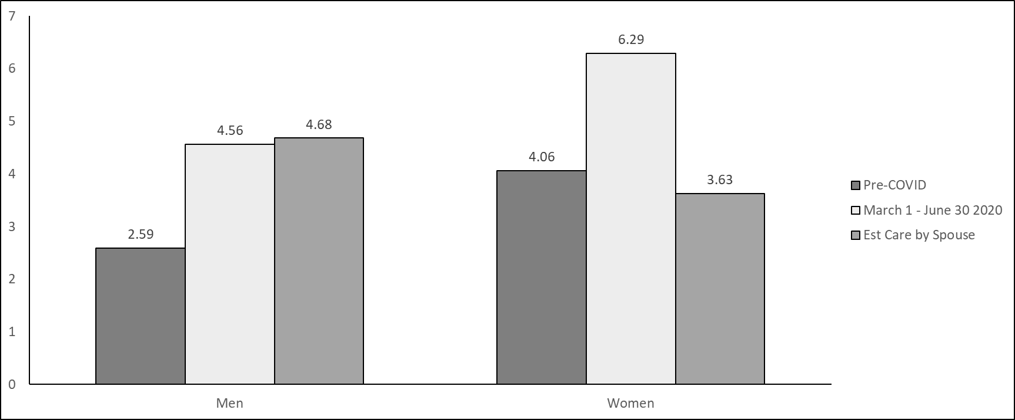
Average hours of unpaid care Pre- & Post-COVID-19
ABS 4.77 hrs per day pre-covid
ABS 2.6 hrs per day pre-covid
4102.0 - Australian Social Trends, March 2009 (abs.gov.au)

Slide 10
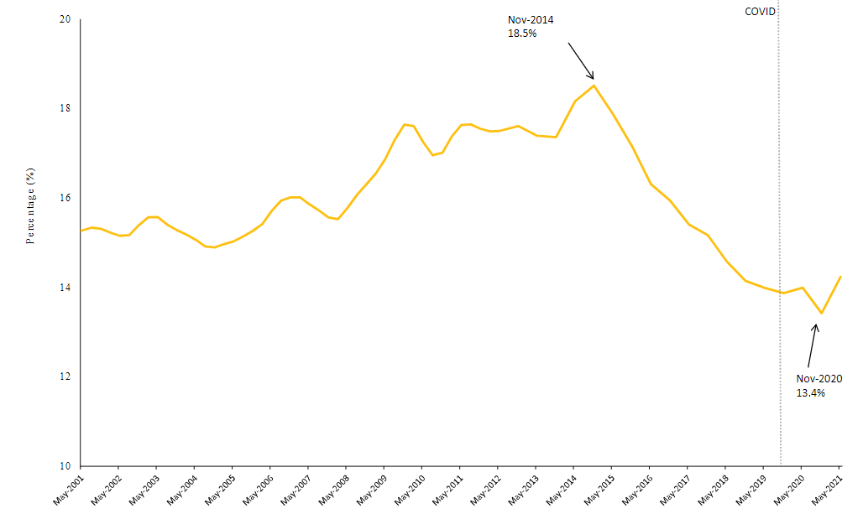
Gender Pay Gap – A Proxy for Structural Bias
On Current Trend based upon economic cycles, it will be the year 2409 before we eliminate the gender pay gap on current trend.
ABS Pay Gap figure only accounts for differences in base salary.
Down 0.7% over 16.5 years
Nov 2004
14.9%
May 2021
14.2%
Federal Stimulus to male dominated sectors in preceding 12 months

Slide 11
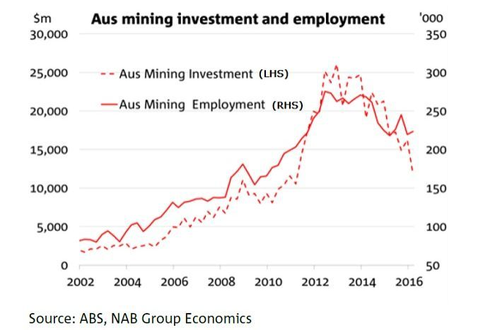
Gender Pay Gap – Linked to Mining?

Slide 12
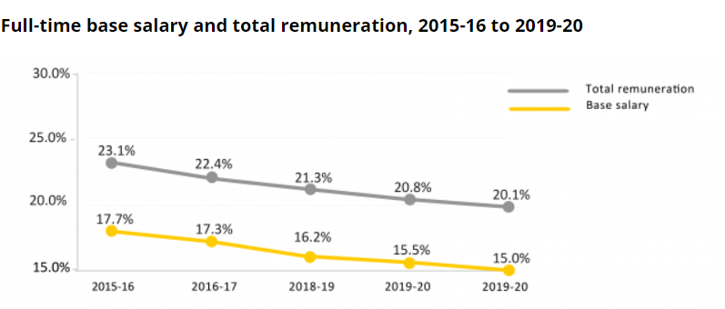
However…The real Gender Pay Gap is far Greater
Gender Pay Gap: Average weekly full time remuneration pay gap in Australia is 20.1%. The difference is comprised* of:
Industry Segregation (20-30%)
Level within Hierarchy (15-20%)
Position within Band (10-15%)
Discrimination/Bias (30-50%)
5.1% Difference between full remuneration and base salary gap
* These numbers are compiled from a broad range of studies. There is still no definitive study on how these proportions trend or can be predicted over time.

Slide 13
All Inclusive Gender Pay Gap
On the current ABS calculations, the pay gap is 14.2% - or the equivalent of about two months more that women need to work to earn the same as men.
But this is just one way to measure it. If we expand the data set to include the average weekly earnings data on earnings for all hours worked, including overtime and part-time/casual workers, the results are even more sobering.
On this measure, the national gender pay gap more than doubles to 31.3%. This means women’s average weekly total earnings are $486.20 less per week than men.
International Equal Pay Day: Myth busting the gender pay gap in Australia (WGEA, 2021)
https://www.wgea.gov.au/newsroom/international-equal-pay-day

Slide 14
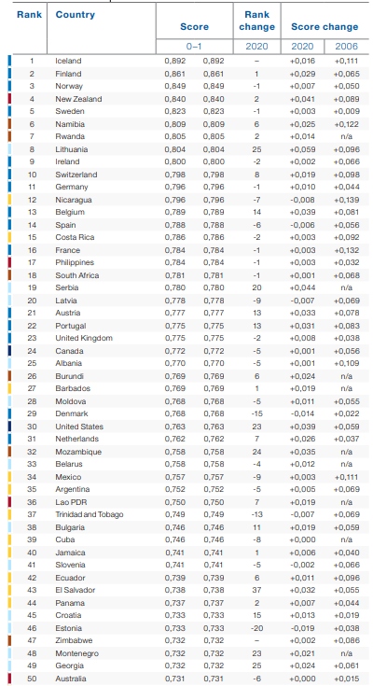
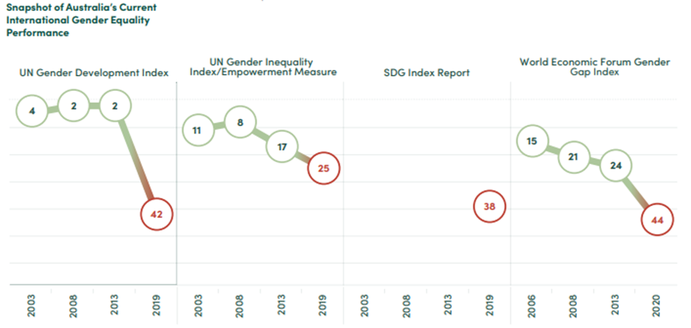
Australia drops 35 places in 16 years
50
World Economic Forum – Global Gender Gap Report 2021 –
(In 2005 Australia ranked 15th)

Slide 15
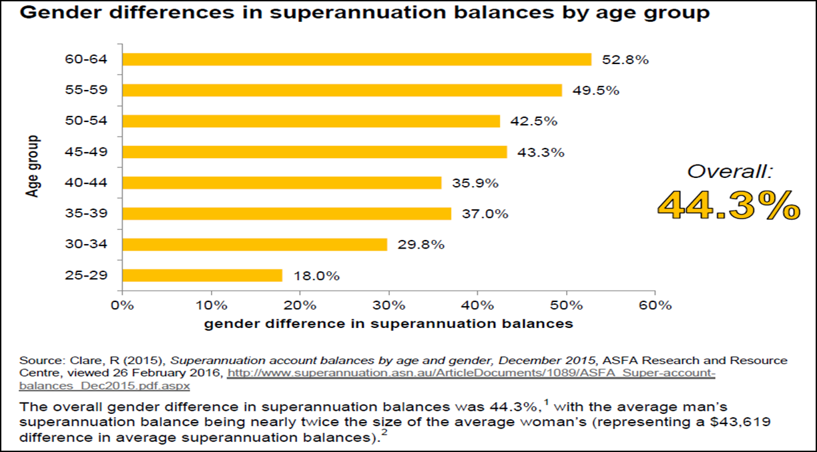
Gender Pay Gap – Impact upon Retirement Outcomes
As the gender pay gap declines, so does the difference in retirement balances of superannuation accounts between men and women.
Women retiring in the next few years, will on average, receive 40% less than men.
“Compound interest is the most powerful force in the universe” – Albert Einstein

Slide 16
Linkages to Childhood –
Gender Gap in Pocket Money
Westpac ‘Kids and Money’ Report (2013)
Heritage Bank ‘The Aussie Guide to Pocket Money’ (2015)

Slide 17
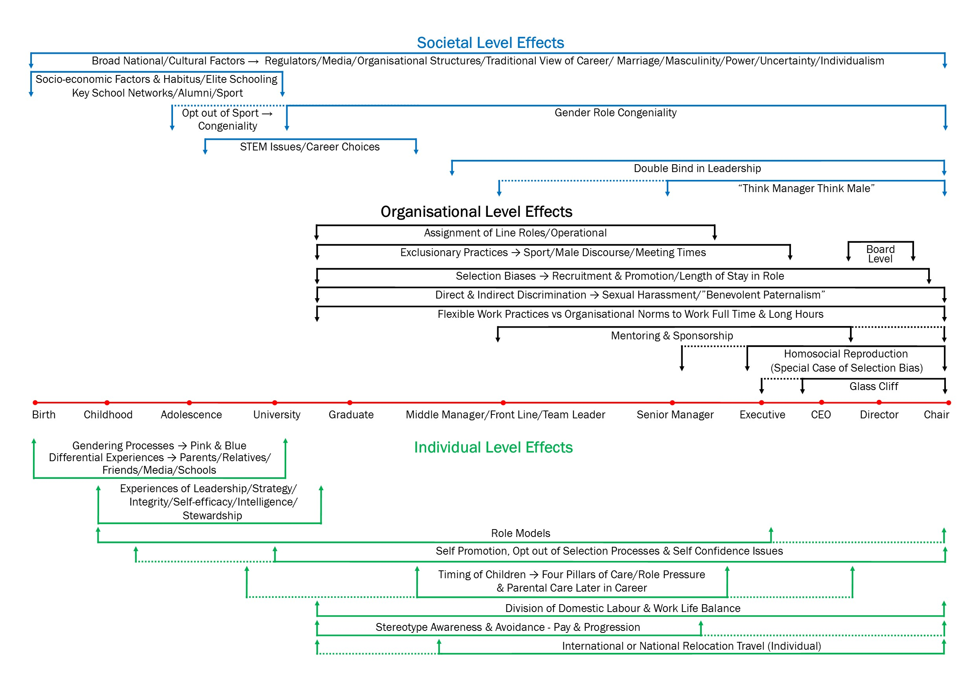
35 Points of Distinction
(Fitzsimmons & Callan, 2016)

Slide 18
‘Hands up for Gender Equality’ Study - 2018
10,076 students from single sex, top matriculation high schools from years 7-11 were surveyed. 500 interviewed.
In line with hypotheses by researchers such as Bandura (1997), anecdotal evidence from the Australasian Alliance of Girls Schools indicated that single sex education might be reducing the effects that can undermine girls confidence in co-educational environments.
We also wanted to test whether these factors might also lead to equal numbers of girls wishing to undertake STEM careers or careers in traditionally male sectors of the economy.
https://bel.uq.edu.au/files/28153/Hands_up_for_Gender_Equality.pdf

Slide 19
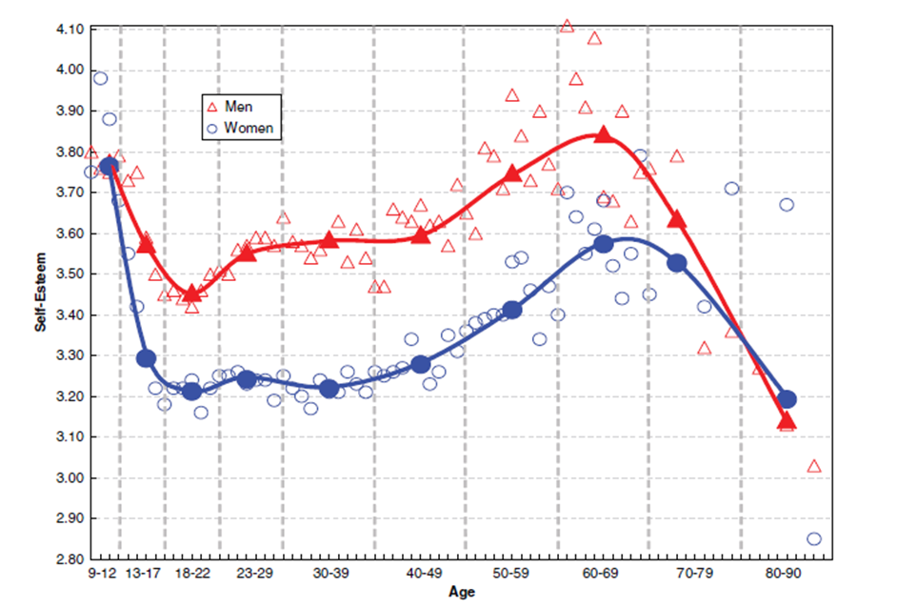
It Starts Early - Parents & Teachers
Amid ongoing debate regarding women’s confidence and links to women’s relative lack of leadership progression, exemplified by Sheryl Sandberg’s ‘Lean-in’ and dozens of studies showing women’s lack of self-confidence relative to men, the “Hands Up for Gender Equality” study examined the conditions which might give rise to this phenomena and the effect they might have upon career intentions.
Mean level of self-esteem for males and females across the lifespan (Bleidorn et al., 2015).

Slide 20
Results - Self Efficacy
There were no statistical differences between boys and girls in years 7-11 in Self-Efficacy Scores
Team sport, leadership development and travel were the most significant contributors to self efficacy development and contributed equally to children’s development regardless of gender
This is very significant and indicates that under certain circumstances men’s and women’s confidence can be the same.

Slide 21
What can Explain this Result?
Gender bias in the co-ed classroom – (Poorer behaviour in boys is acceptable)
Gender bias in the co-ed classroom – (Expectations of academic achievement lower for girls, particularly in STEM)
Role Modelling of Gender Stereotypes in schools (Teacher & Admin Roles)
Competition for Leadership and Voice between boys and girls (Leadership Roles and Development)
Boys accentuate physical changes in girls during puberty (Causing more girls to opt out of Sports)
Girls tendency to be more concerned about interpersonal relationships than boys, including early relationships with boys
Parental expectations around educational and career outcomes (STEM)
These factors are virtually eliminated in Single Sex School environments. However…

Slide 22
Career Intentions
Boys had a greater and earlier understanding of their mother’s and particularly their father’s occupations.
In Year 7, 15% of Girls could not name either their mothers or fathers occupations. Whereas only 6% of boys did not know. Girls in Year 11 still stood at 9%
Similarly, boys had a greater and earlier understanding of their mother and particularly their father’s university degrees or qualifications.

Slide 23
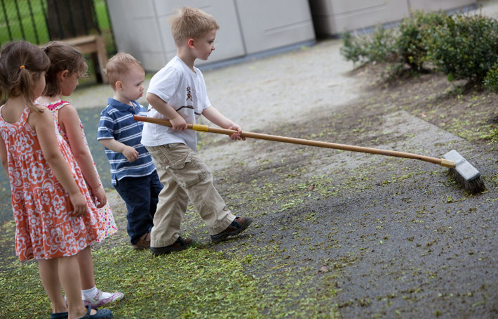
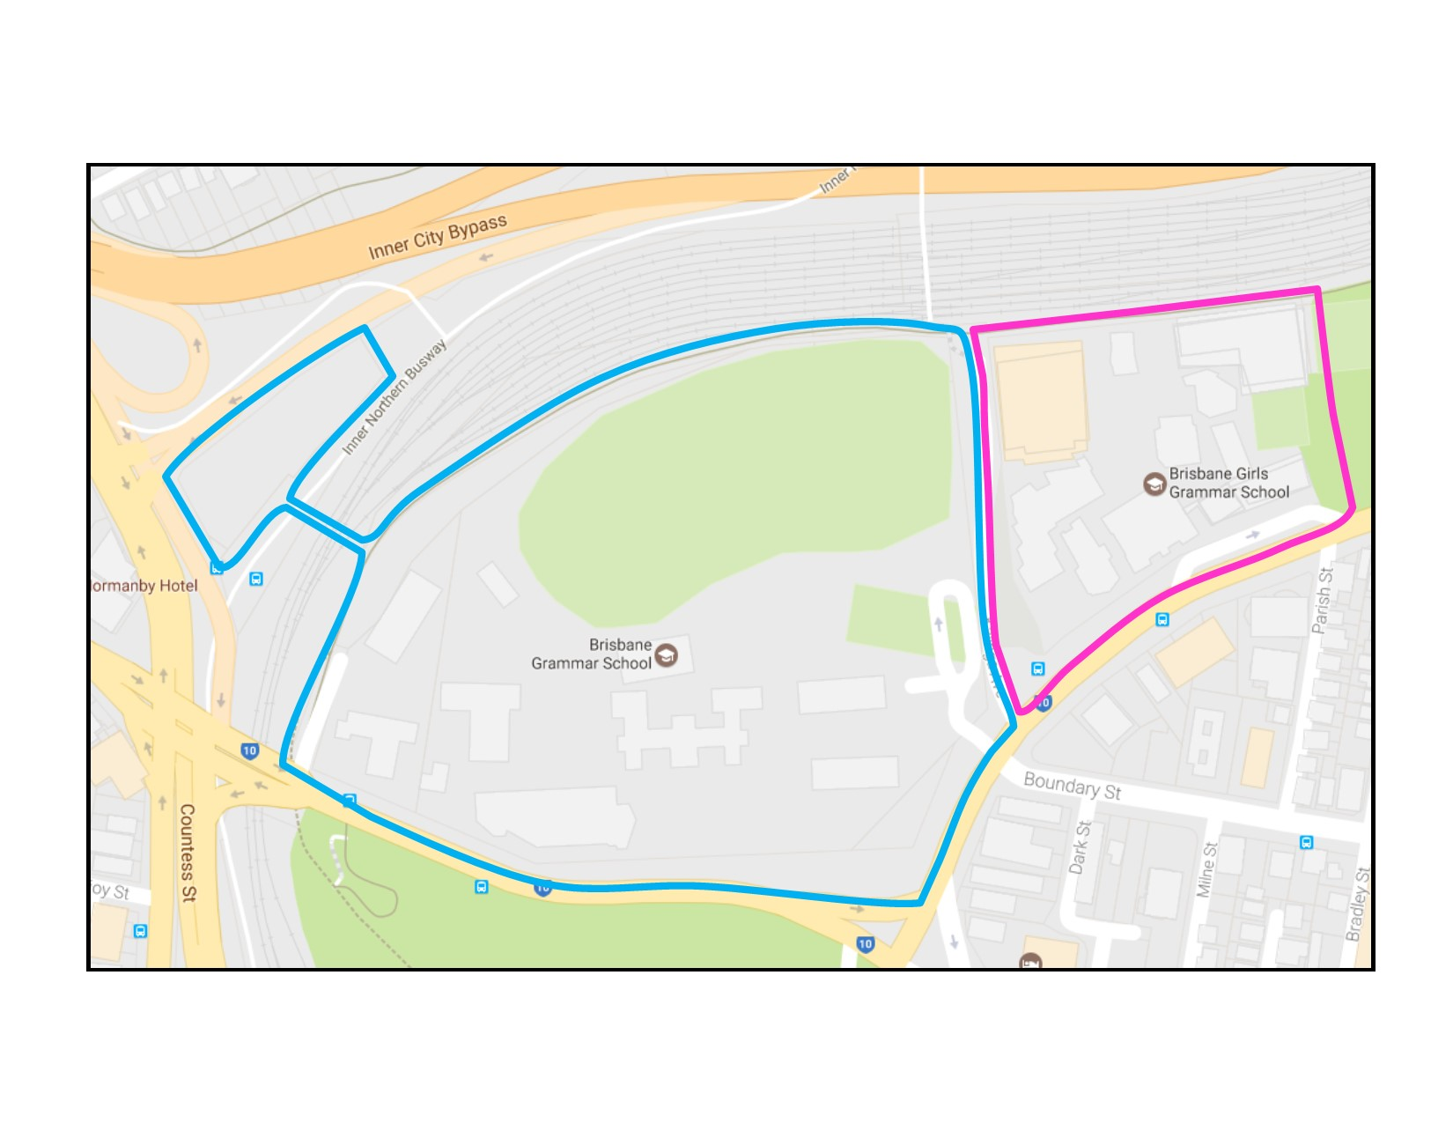
Division of Labour & Career Intentions
Boys undertook both indoor and outdoor chores, however a majority were outdoors.
The majority of chores undertaken by girls were indoors.
The top ten boys schools occupy 1.5 times the physical space of the girls schools and the boys schools have 3 times the outdoor play space (This is true in every Capital city).
What is this saying about the nature of work (and play) to our children?

Slide 24
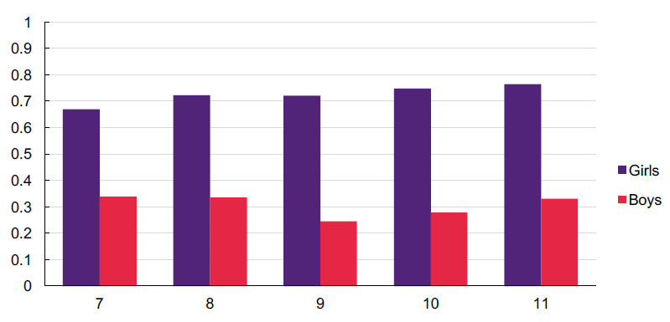
Career Intentions & Chores
At face value, chores may seem like a trivial detail to focus our attention on. However, we know that from much of the leadership literature, and gender role attitude literatures, that internalised beliefs about ‘what men should do’ and ‘how women should behave’ do indeed translate into downstream career outcomes via a range of different mechanisms and processes within schools, universities and workplaces.
Relative time spent on indoor chores by boys and girls by year level in hours per day

Slide 25
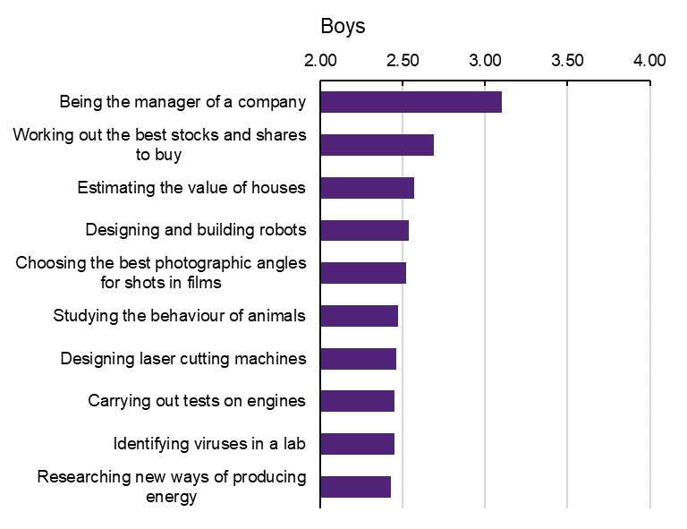
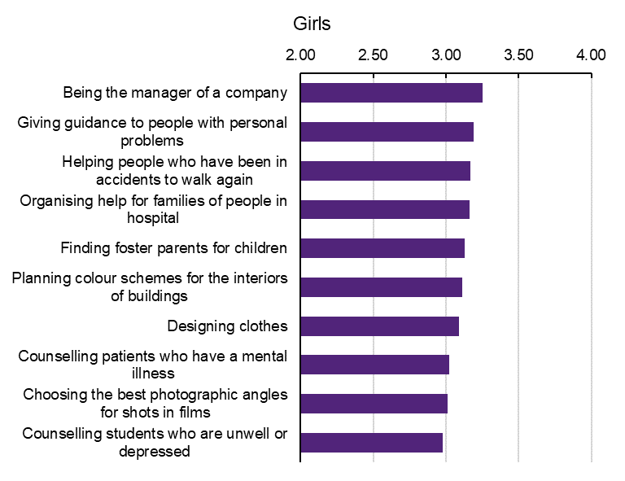
Rank and Importance of Career Interests in Year 11
Average Importance of Year 11 Boys’ Top 10 JIIG-CAL Choices (n= 592-628)
Average Importance of Year 11 Girls’ Top 10 JIIG-CAL Choices (n= 730-743)

Slide 26
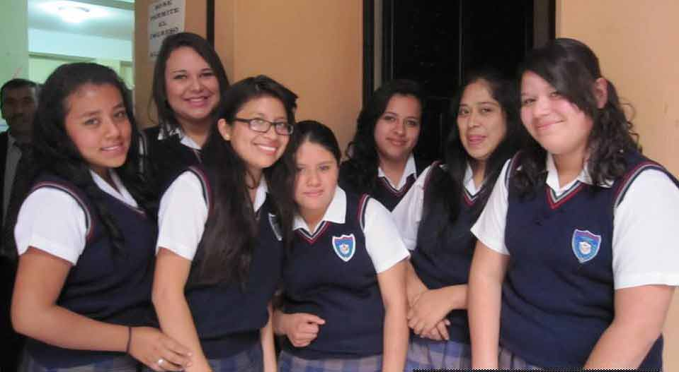
Career Interests & the Future of Work
Career interests for boys and girls differed significantly in Year 7 and remained virtually unchanged throughout High School.
Boys dominated technology, chemistry and physics.
Girls dominated social services and healthcare.
For career interests the implication is clear: If we are going to influence women’s STEM or operational career intentions, then interventions must take place as early as possible in infants and primary school if not earlier.
This is critical given the key role technology will play in the future of work. (Catalyst, 2019)

Slide 27
What Can Organisations Do?
In February 2020, with the Workplace Gender Equality Agency, we released the ‘Employer of Choice for Gender Equality: Leading Practices in Strategy, Policy and Implementation’ report detailing Australia’s leading 120 firms moving towards workplace gender equality.
Information for the report came from the applications of successful firms seeking the Employer of Choice for Gender Equality Citation. The application process is extremely rigorous and detailed. We examined the citation applications of 120 firms over a five year period to identify leading practices in every area of their organisations.
https://www.wgea.gov.au/aibe-centre-for-gender-equality-in-the-workplace-eocge-report

Slide 28
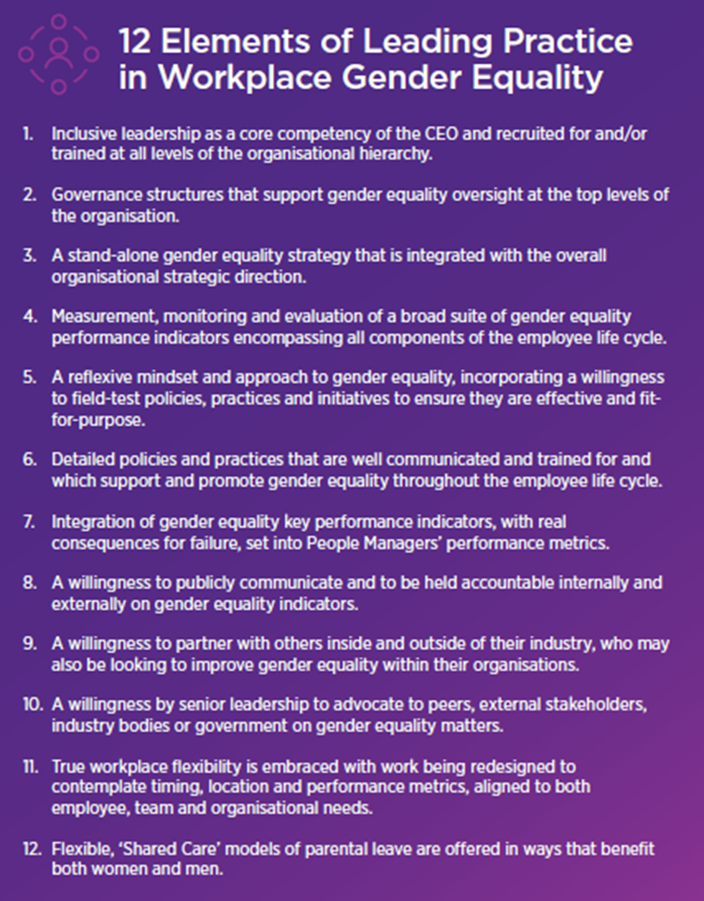
The Good and Bad News
The good news is that it is possible, with the right culture, practices and governance, to drive workplace gender equality.
EOCGE firms have more rapidly shrinking pay gaps, greater numbers of women in senior roles, greater numbers of women overall and greater rates of progression for women than non-EOCGE firms.
However, success requires whole of organisation, long term commitment that starts from the top. Without the genuine commitment of a CEO who manifestly believes and understands the drivers of gender inequality, change will be slow at best.

Slide 29
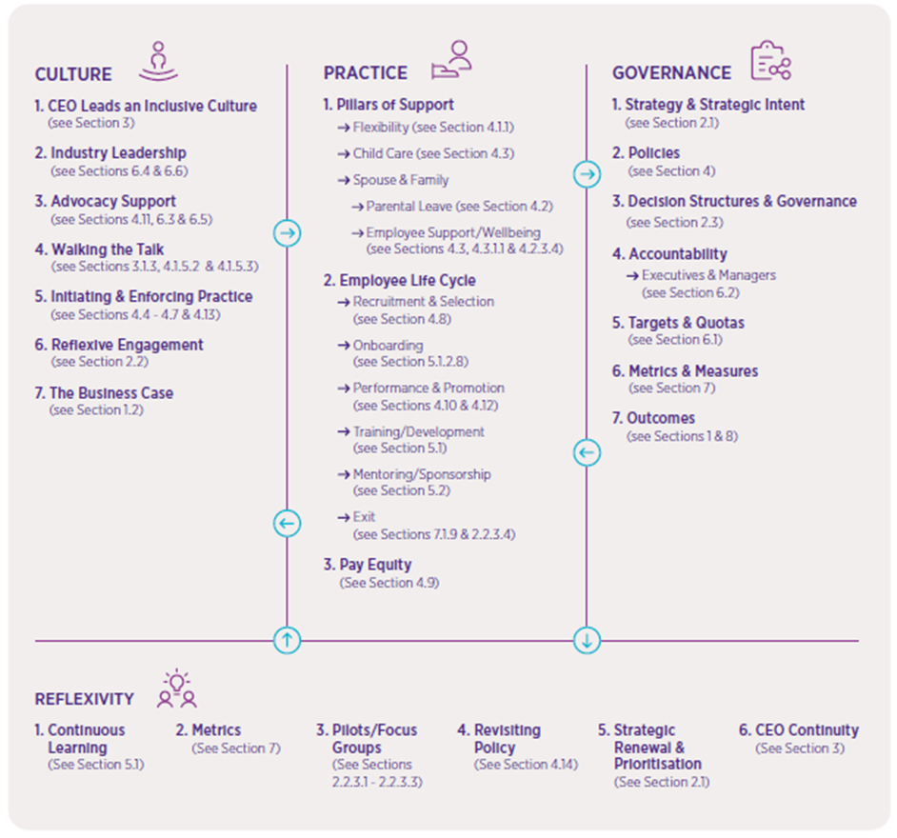
Holistic/Strategic Approach
The figure opposite is a diagrammatic summary of the report.
At a basic level, we identified that leading practice EOCGE organisations have focused upon four key areas:
Creating/sustaining an inclusive culture led by the CEO & Board
A detailed and constantly evolving suite of gender equality practices
Gender equality strategy, underpinned by policies, oversight and accountability for results
Reflexivity & ongoing learning

Slide 30
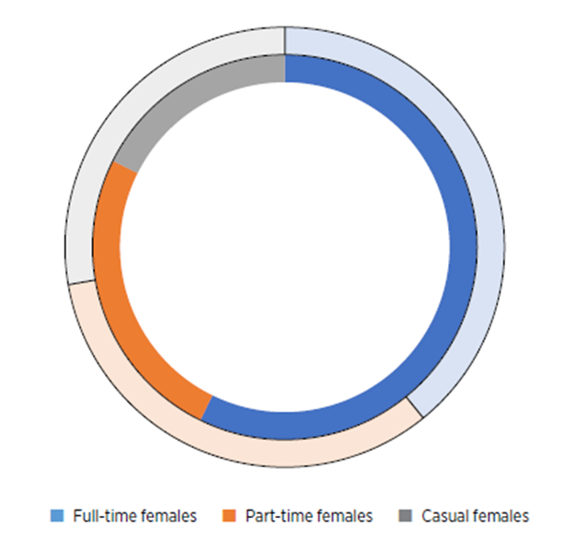
The Right Kind of Flexibility (and Care)
Workplace gender inequality is driven by stereotypes which create and reinforce structures in Society. These act to create a gendered division of labour at home and in the workplace.
To address this we can treat the cause or the symptoms.
Treating the cause will require a whole of society shift to address gendered structures & stereotypes
Hence EOCGE firms work to provide policies and practices which address the symptoms.
Genuine Flexibility
Childcare Provision
Parental Leave
Addressing Workplace Discrimination

Slide 31
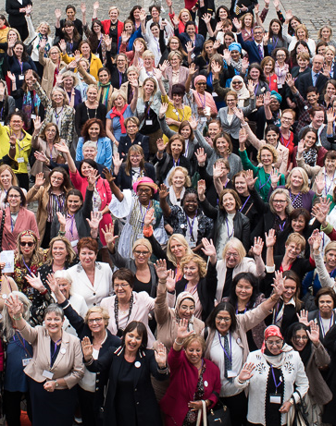
Individual Action - Mobilise, Equip and be Visible
A key feature of EOCGE firms was the existence of formal women’s networks (with men) within the firm. These acted as:
A catalyst for change
A repository of knowledge of workplace gender inequality
A source of expert opinion for developing/testing new gender policies and practices
Advocates for evidence based organisational change
Formal and informal mentors/sponsors for junior women
Sponsors of forums, seminars and workshops to promote gender equality
Hubs for the inclusion and empowerment of senior males to drive organisational change

Slide 32
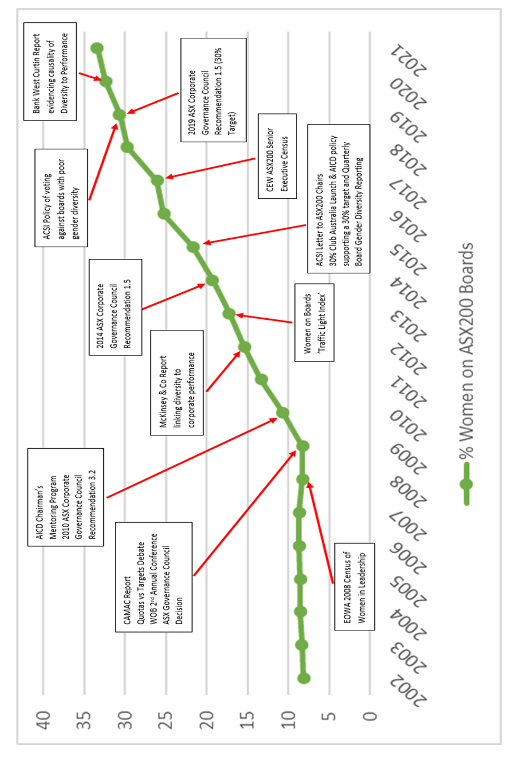
Women on Boards - A Mosaic of Influencers

Slide 33
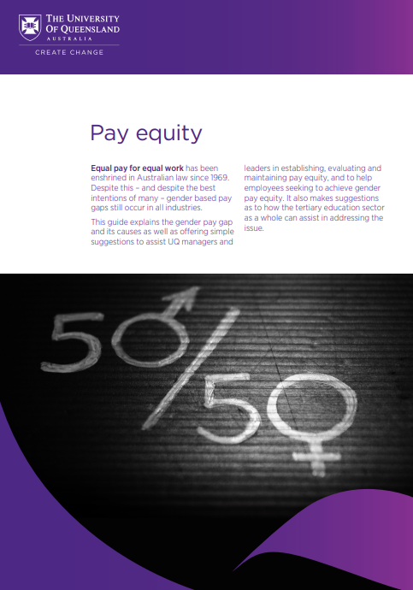
UQ Pay Equity Guide
UQ has recently issued a Pay Equity Guide which summarises the issue of the gender pay gap.
The objective of the guide is twofold:
To make an understanding of the causes and consequences of the gender pay gap accessible to managers and staff alike.
To make all of the resources necessary to address the gender pay gap accessible to managers and staff.
https://about.uq.edu.au/files/7057/UQ%20Pay%20Equity%20Guide.pdf

Slide 34
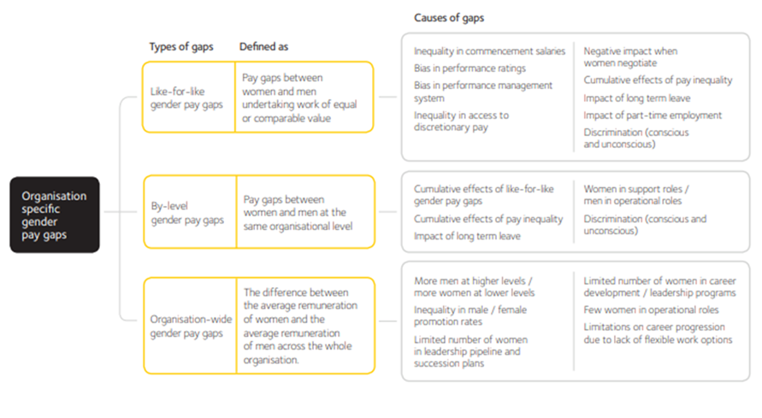
UQ Pay Equity Guide
The Guide is divided into the following sections:
What is the Gender pay Gap?
What is the impact of the Gender Pay Gap?
Separate sections for Managers and Staff on what can be done to address the gap:
Equipping and resourcing your Human Resources team
Know organisational responsibilities and set clear goals
Conduct regular pay equity audits
Have transparent pay schemes
Check salaries at entry and promotion
Analyse roles in terms of equal value as well as equal work
Factor in all forms of remuneration
Reward output and productivity not just visibility
Treat full-time, flexible and part-time staff equally
Offer equal training and development opportunities
Links to additional tools and resources

Slide 35
THANKYOU

