Slide 1

Asbestos Awareness Session
Health and Safety
2022
A global university Western Australia | Dubai | Malaysia | Mauritius | Singapore

Slide 2
Overview
What is Asbestos?
Asbestos Type – Friable vs Bonded
Curtin University Requirements
What is a Survey?
Asbestos Removal
Further Information
Questions
Notes:
This training has been designed to give you an awareness overview of Asbestos given that there will be potential asbestos removal works being undertaken in work area.
This awareness session will cover:
What asbestos is
Asbestos Type
Curtin University Requirements
What a survey is
Asbestos Removal
Where you can access further information
A questions session at the end

Slide 3
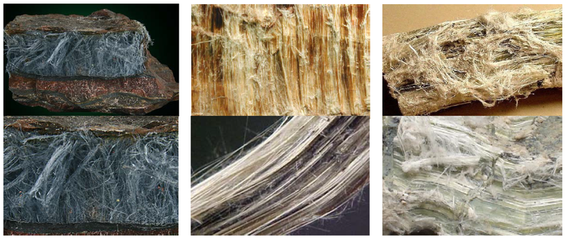
What is Asbestos?
A naturally occurring mineral which is formed like a rock but made up of tiny fibres.
The strong fibres, 50 to 200 times thinner than human hair, can become airborne, is invisible to the naked eye and may be inhaled into our lungs.
Crocidolite (Blue Asbestos) Amosite (Brown Asbestos) Chrysotile (White Asbestos)

Slide 4
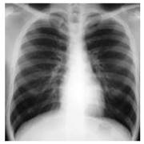
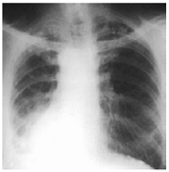
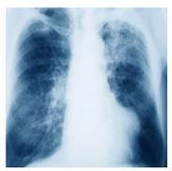
What is Asbestos?
These fibres pose a significant health hazard to people exposed to them and have the potential to cause:
    Asbestosis
    Mesothelioma
    Lung cancer
    Pleural Plaques
    Normal Lung Asbestosis Mesothelioma
Asbestos cement products were commonly manufactured in WA from 1921 to 1987.
The manufacture, importation and installation of products containing asbestos was being phased out during the 1980s and was not used in building materials by the end of that decade.
In December 2003 it was banned entirely - it can no longer be used, recycled or imported.
Notes:
Asbestosis
Progressive scarring of lung tissue: onset 5 -15 years.
Lung cancer
Cancer of bronchial lining or lung: onset 20 years.
Mesothelioma
Large bulky tumours that can fill the chest cavity:
onset 20-50 years.
Pleural plaques
Patches of thickening pleural membrane. No significant disability but indicates exposure to asbestos.

Slide 5
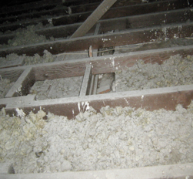
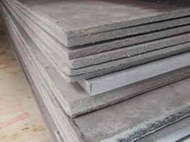
Asbestos Type
Materials which contain asbestos are commonly found in areas likely to experience intense heat, friction, or excessive moisture that would cause other products to deteriorate.
Asbestos containing materials (ACM) are divided into two types:
  Friable ACM
    Friable asbestos containing materials are able to be crushed, crumbled, pulverised or reduced to powder by applying hand pressure.
  Non-friable (bonded) ACM
    Non-friable or bonded ACM are materials that have been made from asbestos fibres and a bonding compound (e.g. cement or a resin binder).
Friable ACM
Non-Friable or Bonded ACM

Slide 6
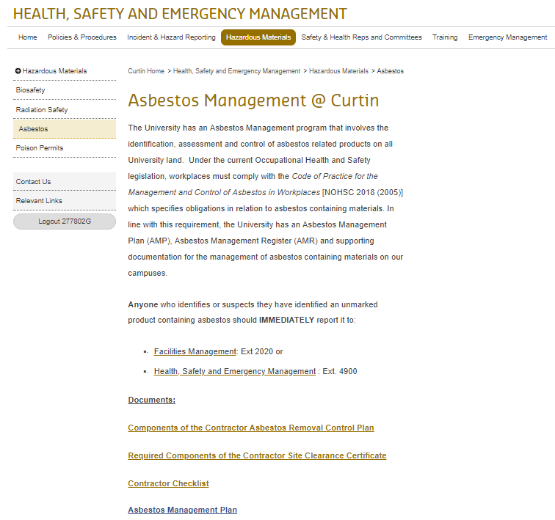
Curtin University Requirements
Responsible for managing the risks of ACM exposure on all University owned locations, in compliance with legislative requirements and the Curtin University Asbestos Management Plan (AMP)
Curtin University's main requirements for managing the risks of ACM exposure in the workplace are too:
  develop, implement and maintain an AMP;
  identify and label all ACM in the workplace, as far as practicable;
  develop and maintain a register of the identified or presumed ACM, including details on their locations, accessibility, condition, risk assessments and control measures;
  introduce control measures to prevent, as far as practicable, the generation of airborne asbestos fibres and exposure to airborne asbestos fibres.; and
  ensure control measures are implemented as soon as possible and are maintained as long as the ACM remain in the workplace.

Slide 7
What is a Survey?
An asbestos survey is an inspection which is undertaken to help you identify the following:
  If asbestos is present
  The condition and type of asbestos
  How to manage the risk of the present asbestos
Survey Types
  Type 2 | Management Survey
    Visual inspection and may undertake sampling to confirm asbestos is present or presuming asbestos is present.
  Type 3 | Refurbishment or Demolition Survey
    Fully intrusive inspection and involves destructive inspections and sampling to confirm the presence of asbestos.
Notes:
Requirements of Surveys
- Generally for a survey you wont see the people conducting the survey wearing any PPE unless they take a sample in which additional controls are in place such as sealing the potential ACM product and then manually cutting a section off and resealing the product

Slide 8
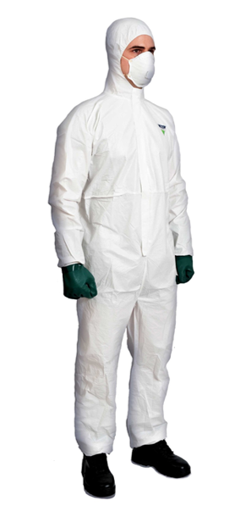
Asbestos Removal
Where possible works are completed outside of normal business hours.
Asbestos Removal Works must be undertaken in compliance with relevant legislation and Curtin's Asbestos Management Plan
Removal must only be carried out by licensed ACM Removal Contractors
An Asbestos Removal Permit must be completed, reviewed and accepted by the Responsible Officer before the work proceeds.
Companies engaged to carry out Asbestos Removal Work must Register, Prequalify and be Approved with the University
Clearance Certificates & Asbestos Disposal Receipts must be forwarded to Health, Safety & Emergency Management on completion of any removal or refurbishment.
Notes:
Specific location barricading requirements
PPE requirements
Decontamination process after removal
All areas are to be notified of any works being undertaken
Safe Work Method Statement (SWMS)

Slide 9
Further Information
Curtin University Asbestos Management Information
  https://healthandsafety.curtin.edu.au/hazardous-materials/asbestos.cfm
Code of Practice for the Safe Removal of Asbestos
  https://www.commerce.wa.gov.au/sites/default/files/atoms/files/saferemoval_ofasbestos2ndeditionnoh.pdf
Code of Practice for the Management and Control of Asbestos in Workplaces
  https://www.commerce.wa.gov.au/sites/default/files/atoms/files/managementcontrolofasbestosinthewor.pdf
Asbestos Removalists Presentation WorkSafe WA
  https://www.commerce.wa.gov.au/publications/asbestos-removalists-presentation

Slide 10

Thank you
Make tomorrow better.

