Slide 1
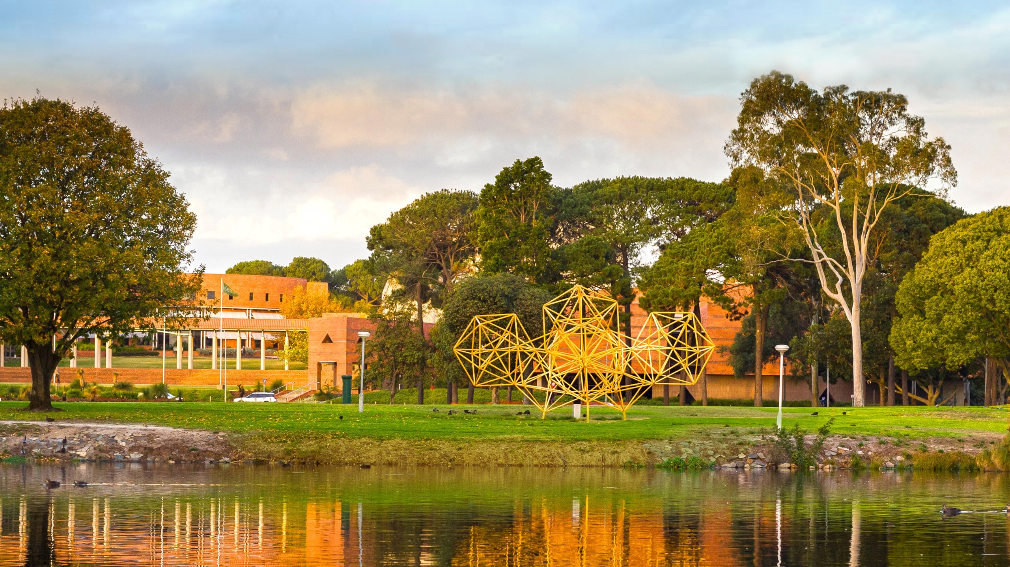
Start-up/Concept/Idea Title
Presenter name
[include additional names if you are in a team]
A global university Western Australia | Dubai | Malaysia | Mauritius | Singapore

Slide 2

Problem
Tell us what is your idea or problem you want to solve:
What is the problem?
Why/how does the problem occur?
How big is the problem?

Slide 3

Target Market
Tell us about:
The customer / end user experiencing this problem?
Why does it affect them?
What do they currently do to solve this problem?
Why don’t existing solutions work?

Slide 4

Solution / Idea / Concept
Tell us about your product / idea / concept:
What is your product / idea / concept?
What does it do / how does it do it?
What makes it novel?

Slide 5

Competition / Competitive Advantage
Who are your close competitors/who does something similar?
What do you do differently to them?
Why would your target market choose your product / idea / concept over other solutions?

Slide 6

Ask
Why do you think you should win the Curtin Global Student Pitch Competition?

