Slide 1
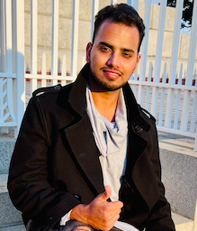
HDR Orientation 2022
Hameed Mohammad – Postgraduate Student Committee President
Ngaala kaaditj Wadjuck Nyungar moort, kura wer yeye, keyen kaadak nidja boodja.
PSC acknowledges the Wadjuk people of the Noongar nation as the Traditional Custodians of this land on which Curtin University stands. We pay our respects to their elder’s past, present and emerging.

Slide 2
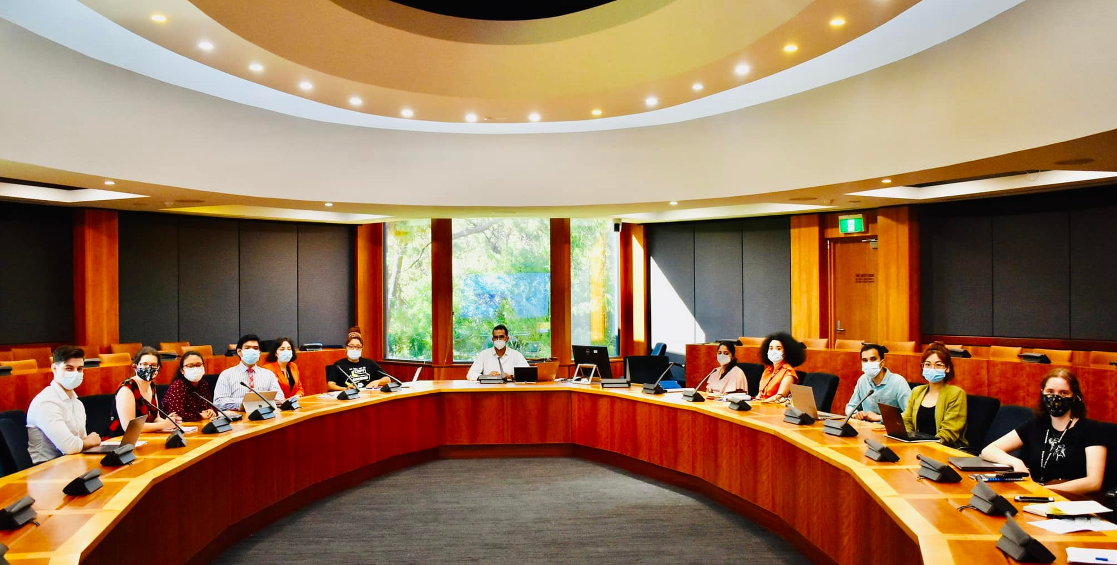
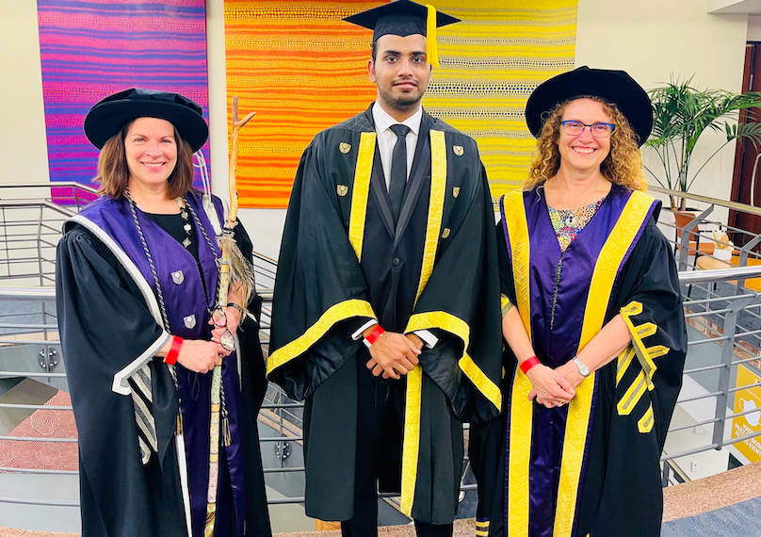
What’s my role?
Chair Meetings of the PSC and facilitate the generation of ideas and initiatives from the committee.
Report to the Guild Council and the Vice President - Education regarding all matters affecting the postgraduate student experience.
Represent your fellow postgrads on high level committees of the university, communicating their experiences and ideas for better postgraduate education.
Ensure representation on all postgraduate level committee so that the student voice is heard from students.
Work closely with student reps, equity reps, VC, DVC and Pro-VCs.
Communicate and engage with the postgraduate student community through social media and events.

Slide 3
A few things to note:
You need a Guild sticker for 2022,
Show your Curtin 2021 Student Sticker for Guild discounts.
These are available from Curtin Connect – Building 102.
Make sure you grab your copy of the Guild diary before they run out!
The Guild Precinct is Building 106, most of our services are here.
Guild Dollars Give Back – money spent at Guild outlets is used to support services and initiatives on campus.
We’re a not-for-profit and we are here to support our student members. Student wellbeing is our number one priority.
3

Slide 4
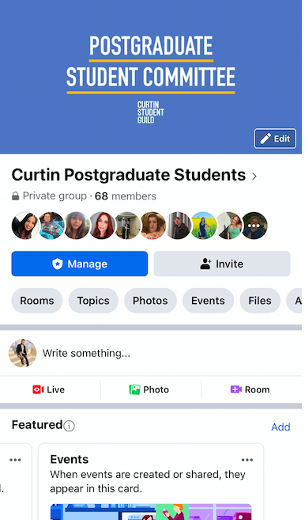
PSC Explained
Prime representative body of postgraduate students at Curtin University (14 years old)
Aims to provide the best postgraduate and research experience at Curtin Student Guild
Activities aimed at improving and promoting academic and research excellence
Representation at various top university committee's both at the university and faculty level
Member of Council of Australian Postgraduate Association (CAPA)
4

Slide 5
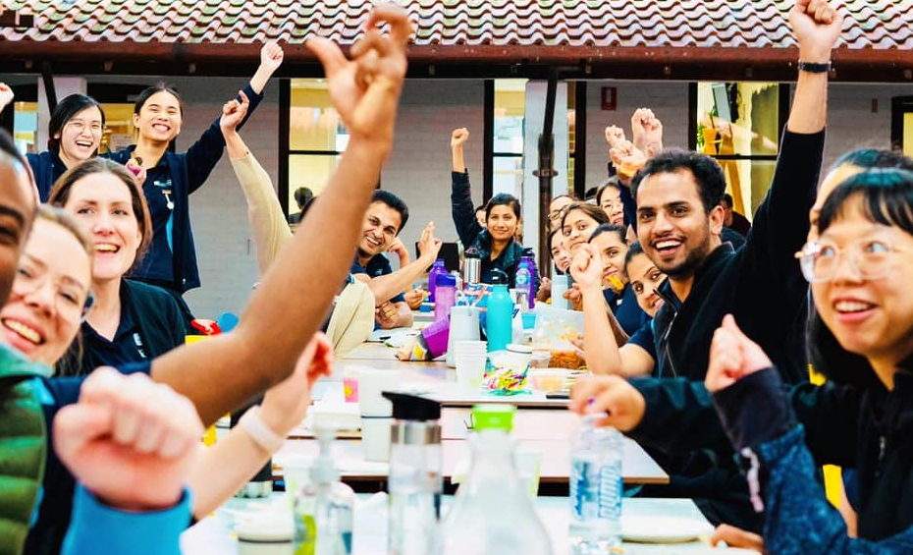
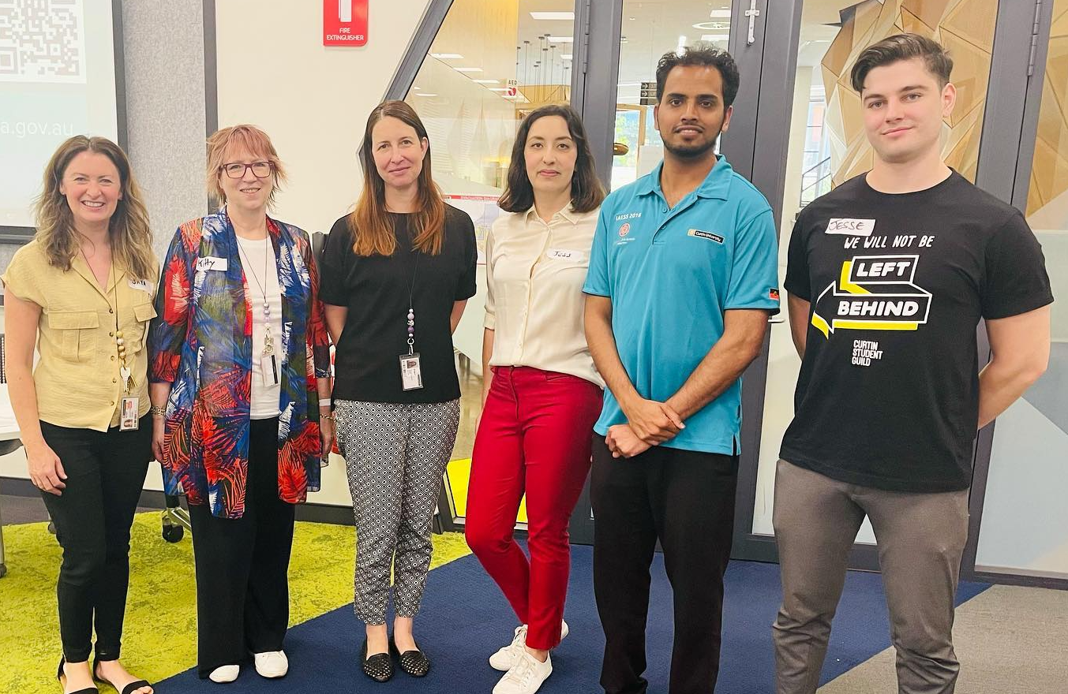
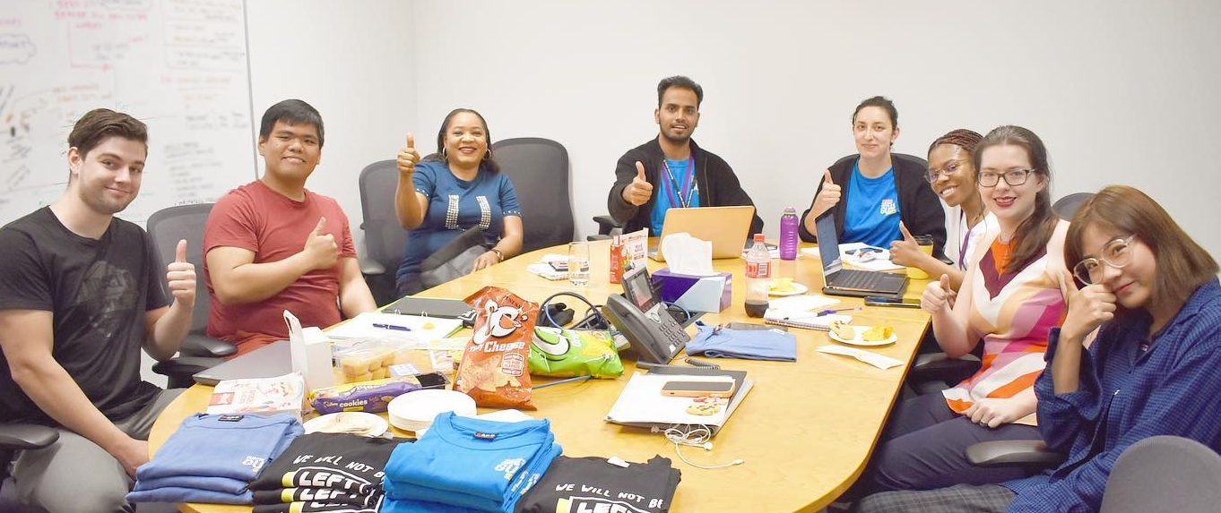
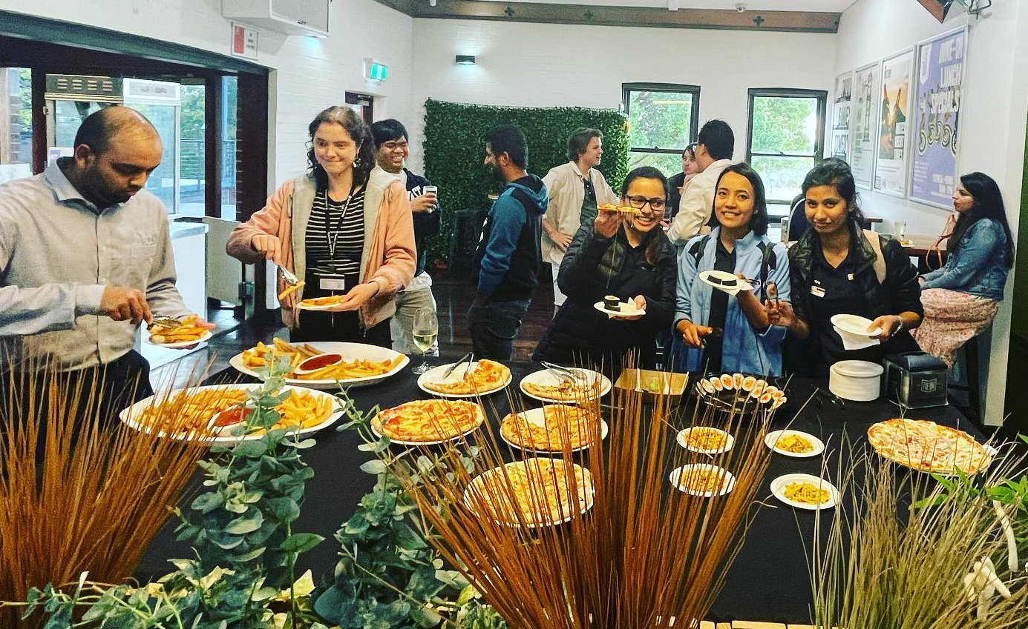
PSC Activities
Research excellence and career development workshops
Social events such as Sundowner, Start of Semester Party, Movies night
O-day participation
CAPA Annual Conference
Representation – Academic Board, Research Committee, Learning & Student Experience Committee, Reps Board
Supporting students through the Covid-19 pandemic
5

Slide 6
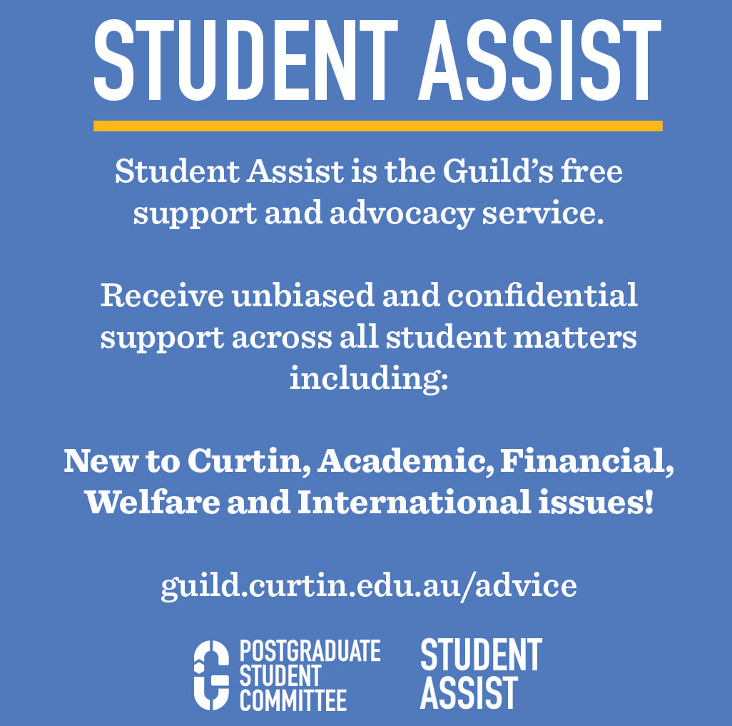
Student Assist
The Student Assist team is a support and advocacy service run by the Guild. They’re unbiased, confidential, and completely independent of Curtin University.
They can help you with:
Academic support
Financial issues
Personal issues
Pop in to see them if you need some help, or even just someone to chat to.
Email: student.assist@guild.curtin.edu.au Phone: (08) 9266 2900
6

Slide 7
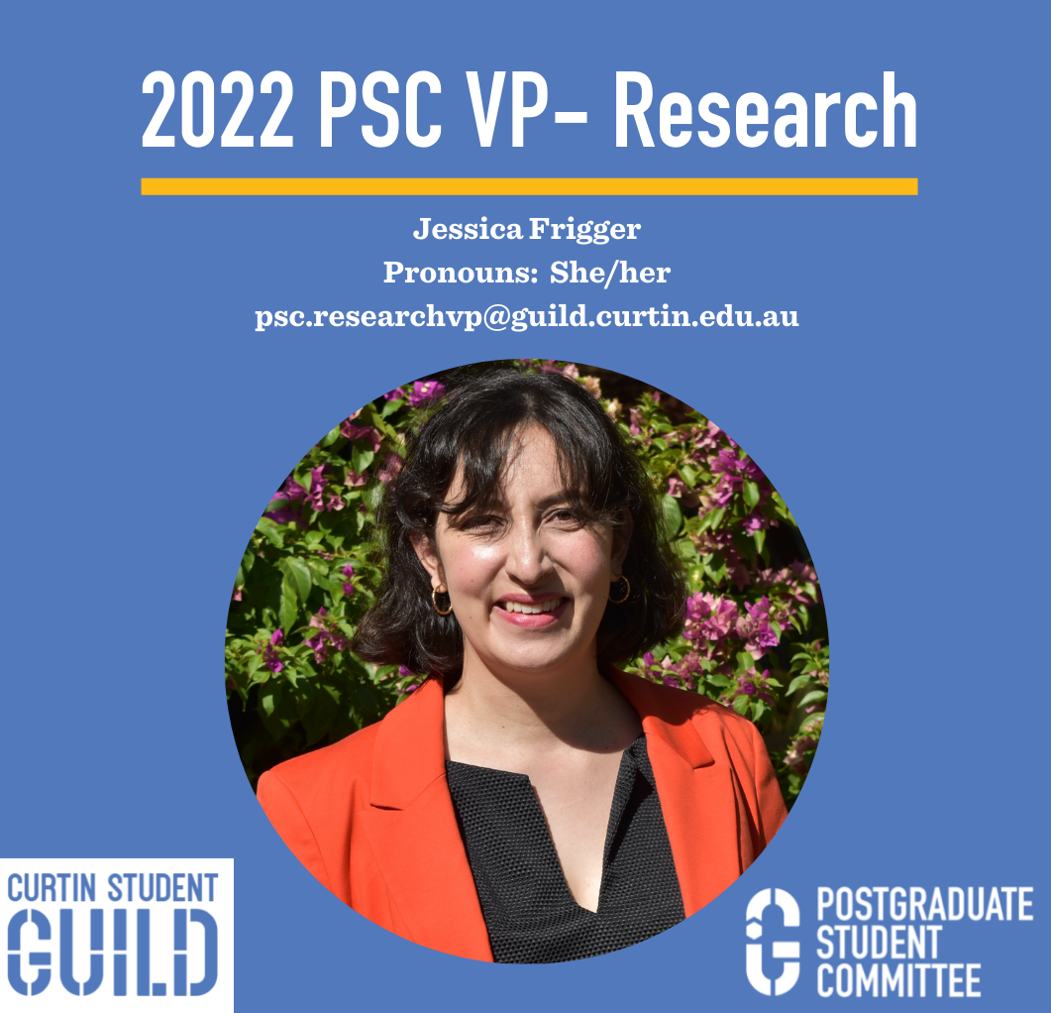
Reach out…..
Issues with HDR supervision
Financial or mental health issues
Issues related to research projects
Communication with supervisor
Viability of research project, etc
Academic Misconduct
Suggestions for projects related to PSC events and activities
7

Slide 8
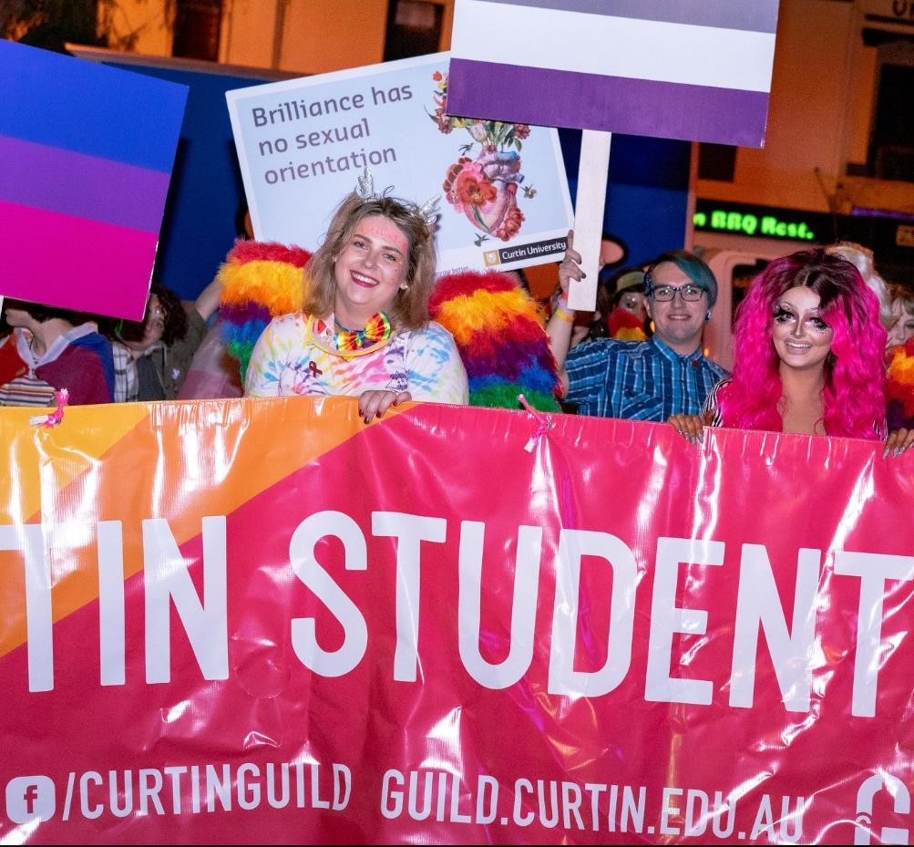
Equity Departments
The Equity Officers exist to get the best outcome for students an all issues that impact them across the following departments:
Queer Department
Women’s Department
Indigenous Department
Students with Disabilities Department
We also have a First Nations Officer ☺
8

Slide 9
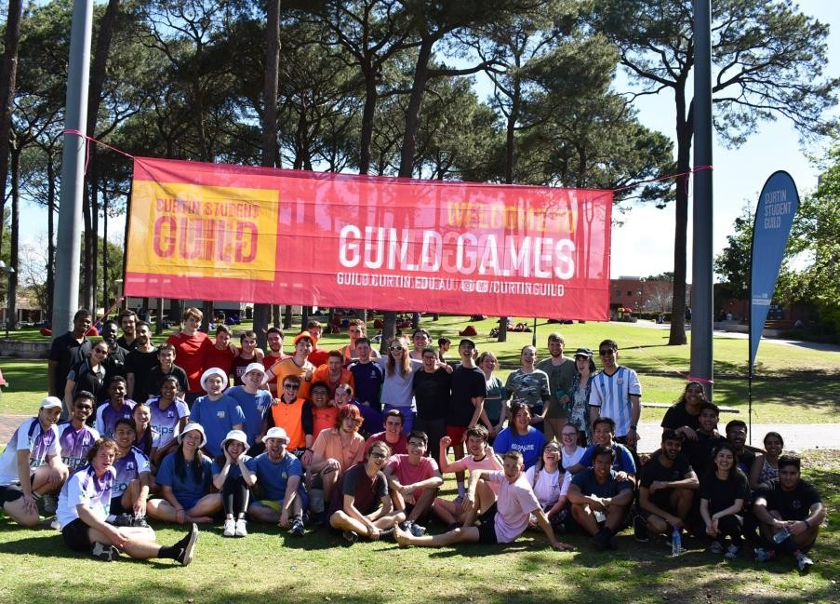
Campus Culture!
CLUBS AND ACTIVITIES
There are over 210 clubs at Curtin – don’t miss your chance to check them out at Guild O Day
Campus events such as Pasar Malam, Guild O Day and Tav Parties
Free food!
FOOD OUTLETS
You got Guild? 10% discount at our outlets.
Collect your free guild sticker to put on your Student ID
card
Collect your free Guild Diary before they run out!
9

Slide 10
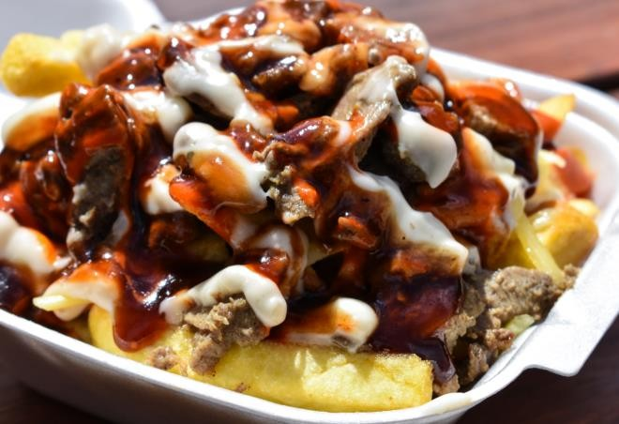
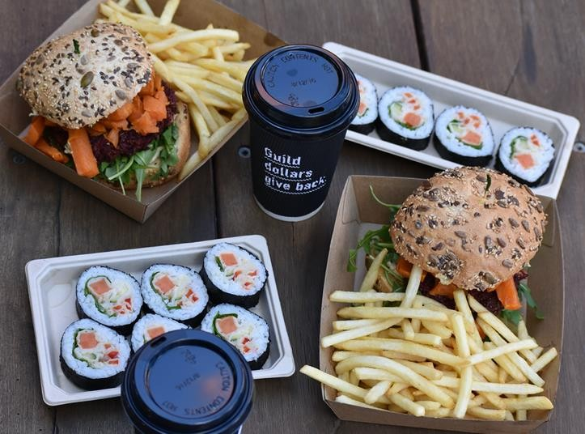
Food and Beverage
The Guild caters and runs seven outlets on campus to keep you fuelled up with food made fresh daily at student friendly prices. We’re all over campus:
Angazi – Curtin Business School.
Concept Café – Guild Precinct (Building 106)
Basement – Engineering Building
Bookmark – TL Robertson Library
Main Café – Building 104
The Vege Patch (and The Cubby) Elizabeth Jolley Lecture Theatre
Hot Stuff - Guild Precinct (Building 106)
The Bubble Lab – Guild Precinct (Building 106)
Check your diary for a map of places to eat (or visit our website).

Slide 11
The Tav
A social hub, the Tav hosts regular events to keep you busy on campus as well as offering $12 daily specials and the much loved Happy Hour from 4-5pm.
You can also book the Tav for:
Private birthday parties
Fundraisers
Club events
11

Slide 12
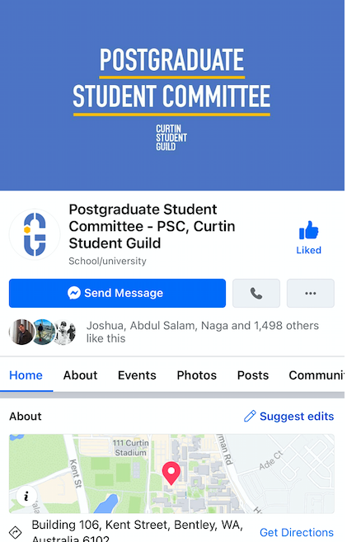
Get in touch
PRESIDENT
psc.president
RESEARCHVP
psc.researchvp
COURSEWORKVP
psc.courseworkvp
HUMANITIES
psc.humanities
BUSINESS & LAW
psc.cbs
…@guild.curtin.edu.au.
Call 9266 2900 or email hello@guild.curtin.edu.au or drop in at Building 106F
12

